Slide 1

ADM Formalism
Abid Jeem || Quantum Gravity

Slide 2
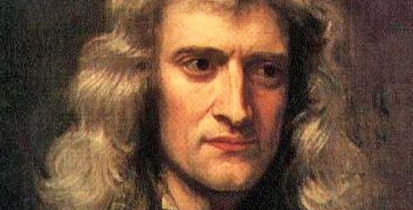
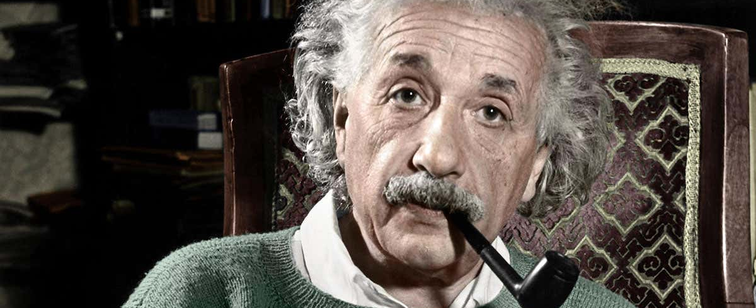
Brief Introduction to General Relativity
Space and time are fixed; gravity is “mysterious” action-at-a-distance and it acts WITHIN space and time
Gravity is NOT a force; it is something that emerges from the interaction of space and massive objects

Slide 3
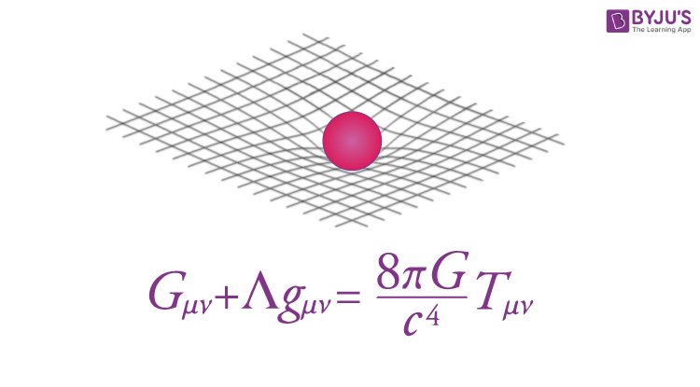
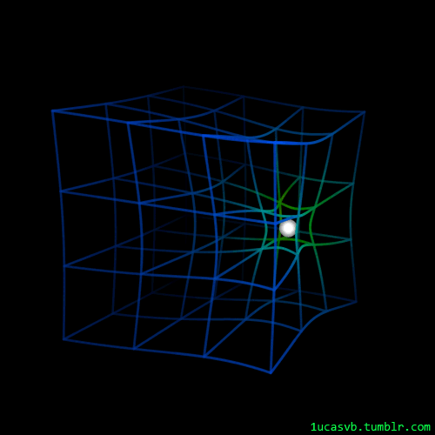
Key Elements of General Relativity
Spacetime Fabric
Gravity as Curvature
Equivalence Principle
Einstein’s Field Equations
These equations describe how the presence of mass and energy “tells” spacetime how to curve, and this curvature “tells” objects how to move
Notes:
Spacetime Fabric:
GR posits that space and time are interwoven into a 4D (3 spatial, 1 time dimension) continuum known as spacetime. This fabric of spacetime is curved by the presence of mass and energy.
Gravity as Curvature:
In this framework, gravity is not a force but the effect of the curvature of spacetime caused by massive objects. Planets, stars, and galaxies move along paths determined by this curvature.
Equivalence Principle:
A cornerstone of GR is the equivalence principle, which states that the effects of gravity are locally indistinguishable from the effects of acceleration. This principle led Einstein to the idea that an observer in free fall is equivalent to being in an inertial (non-accelerating) frame of reference without a gravitational field.
Einstein's Field Equations:
The theory is encapsulated in Einstein's field equations, a complex set of ten interrelated differential equations. State how the animation is an accurate depiction of spacetime

Slide 4
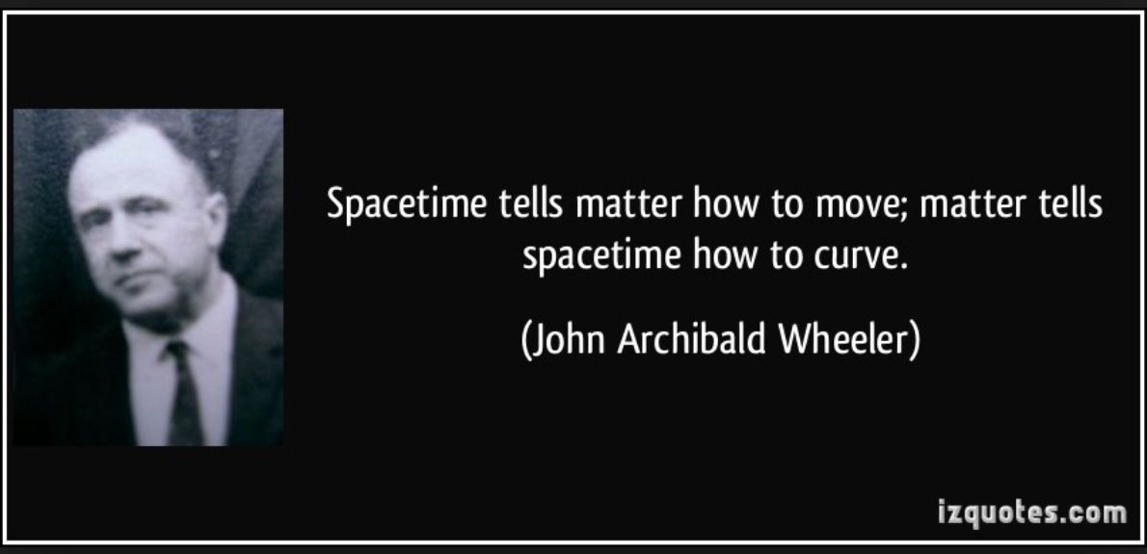
GR in a nutshell

Slide 5
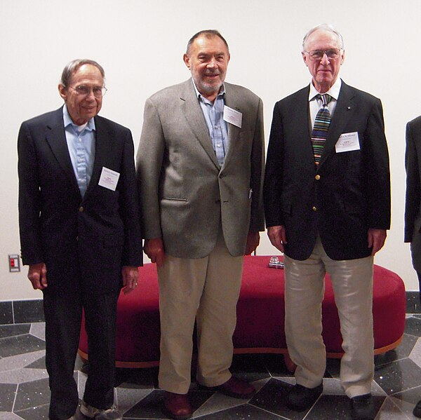
History of ADM formalism
Direct extension of Einstein’s GR to address the complexities in applying GR to dynamic, non-linear systems
Authors:
Richard Arnowitt
Stanley Deser
Charles W. Misner
Published 77 years ago in 1962
Notes:
1. Mention the seminal paper here published in 1962 titled ”The dynamics of GR”, which provided a comprehensive description of its methods and applications

Slide 6
Importance of ADM formalism in numerical relativity
Framework for Simulating Spacetime Dynamics:
Provides a robust mathematical framework for numerically simulating the dynamics of spacetime, essential in understanding complex relativistic systems
Decomposition of Spacetime:
Decomposes 4D spacetime into a series of 3D spatial slices. This "3+1" decomposition makes the complex equations of GR more manageable for computational methods
Facilitates Einstein's Field Equations:
Reformulates Einstein's field equations into a set of equations that are more amenable to numerical analysis by separating into two types: constraint equations and evolution equations
Predicting Gravitational Waves:
Pivotal in predicting the properties of gravitational waves, a major prediction of GR, which was confirmed by LIGO observations in 2015
Notes:
Framework for Simulating Spacetime Dynamics:
Provides a robust mathematical framework for numerically simulating the dynamics of spacetime, essential in understanding complex relativistic systems like colliding black holes or neutron stars
Decomposition of Spacetime:
It achieves this^ by decomposing four-dimensional spacetime into a series of 3D spatial slices, evolving over time. This "3+1" decomposition makes the complex equations of General Relativity more manageable for computational methods
Facilitates Einstein's Field Equations:
Reformulates Einstein's field equations into a set of equations that are more amenable to numerical analysis by separating two types: constraint equations and evolution equations
Predicting Gravitational Waves:
ADM formalism has been pivotal in predicting the properties of gravitational waves, a major prediction of General Relativity, which was confirmed by LIGO observations in 2015.

Slide 7
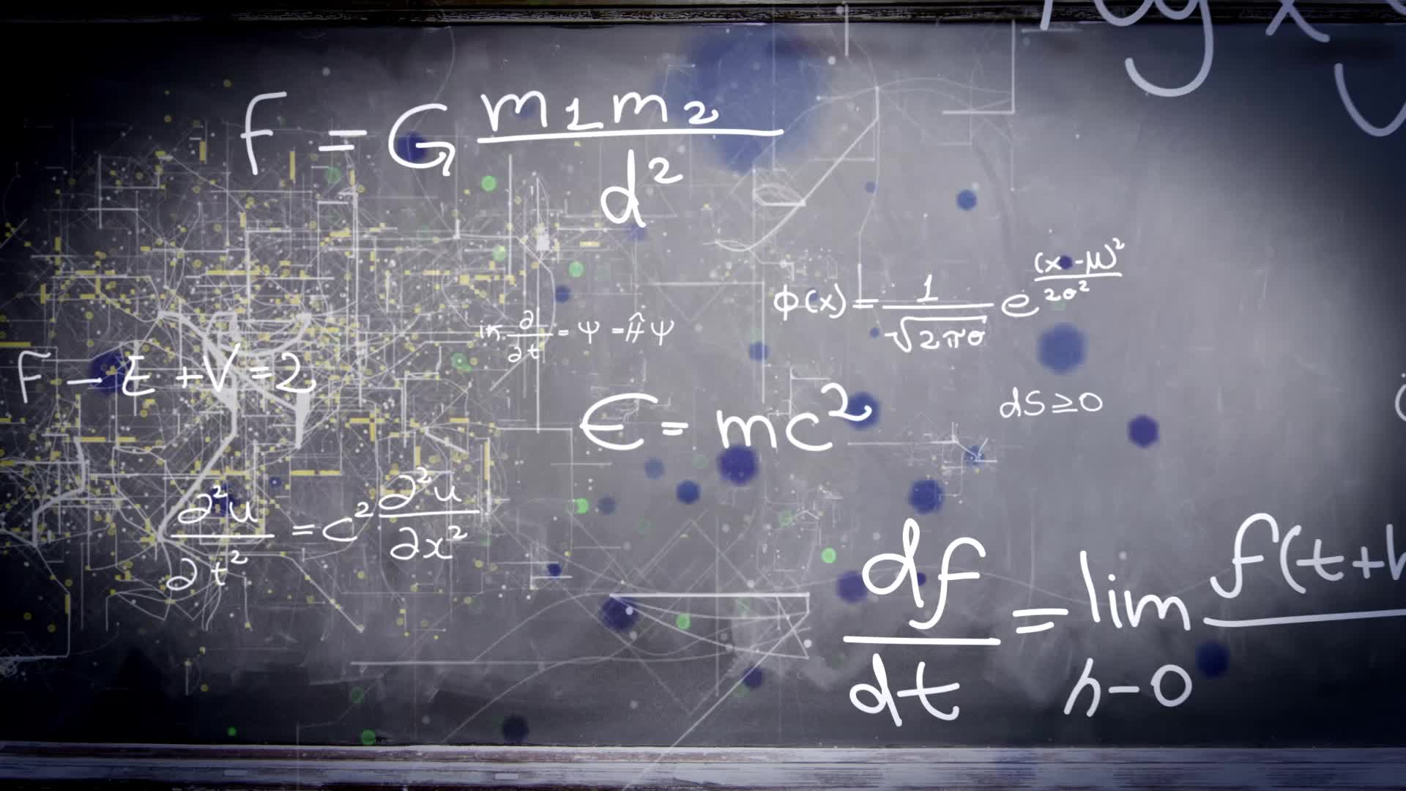
ADM Variables
A set of parameters used in ADM formalism for reformulating Einstein’s field equations
Notes:
A set of parameters used in ADM formalism for reformulating Einstein’s field equations—essential for the “3+1” spacetime decomposition approach

Slide 8
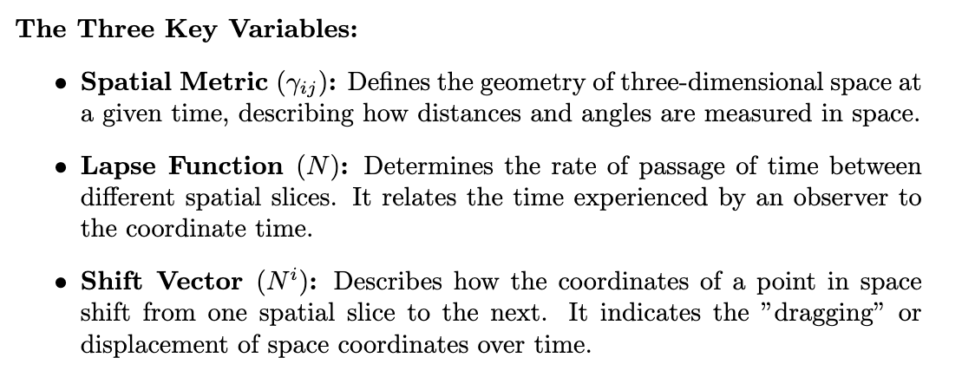

Slide 9
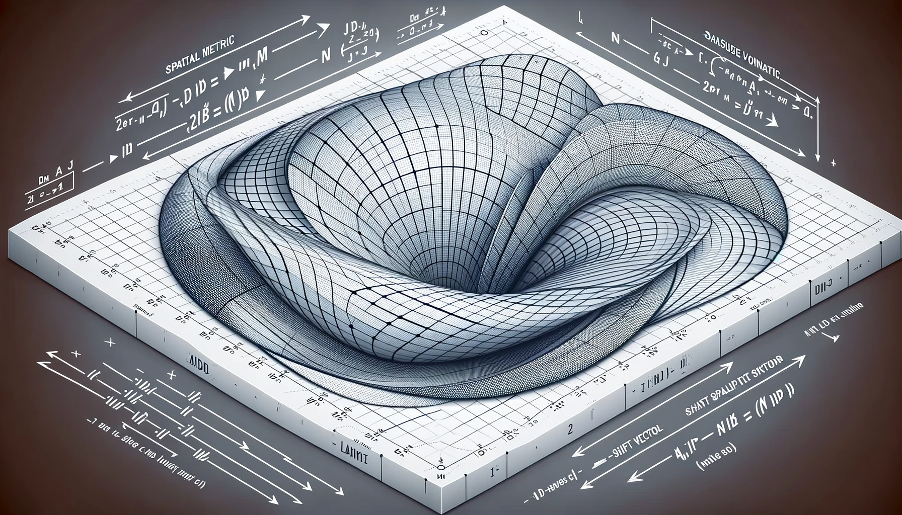
Notes:
The spatial metric is the grid or mesh over a curved surface, representing the geometry of three-dimensional space.
The Lapse Function (N), with a series of spatial slices having varying distances between them, symbolizing the passage of time between slices.
The Shift Vector (N^i) are arrows on a spatial grid indicating the shifting or displacement of space coordinates over time.

Slide 10

Mathematical Formulation of ADM Formalism
3+1 Decomposition
ADM Action
Notes:
Integral components of ADM that serve different roles in the theoretical framework

Slide 11
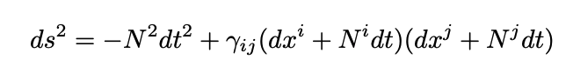
3+1 Decomposition
ADM formalism involves decomposing the spacetime metric (4D) into spatial (3D) and temporal parts
This is achieved using the line element in GR:
Spacetime
interval
Lapse
function
Spatial
metric
Shift
vector

Slide 12
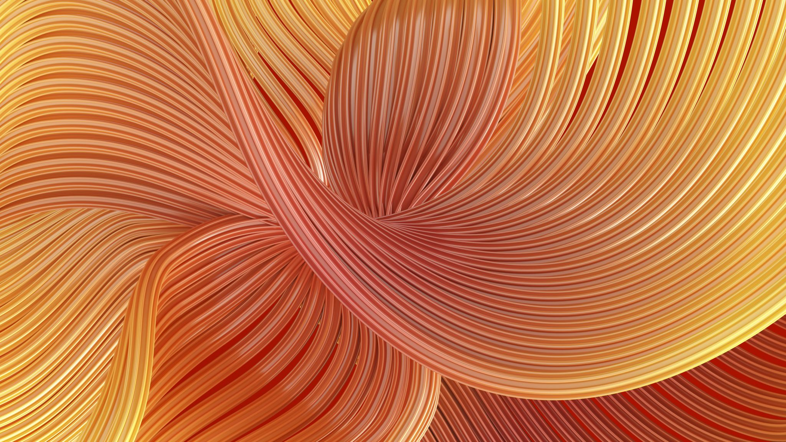
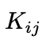
Derivation of ADM Action
Reformulates Einstein-Hilbert Action (integral of the Ricci scalar curvature over spacetime) in terms of the variables defined by the 3+1 decomposition method
01
4D Ricci Scalar ➔ 3D Spatial Quantities AND terms for lapse and shift
02
Extrinsic curvature Kij connects the time evolution of the spatial metric to the geometry of spatial slices
03

Slide 13
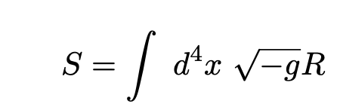
ADM Action
Decomposes 4D of the Einstein-Hilbert Action
Extrinsic curvature tensor representing how the spatial slices are embedded in spacetime
Determinant
Of spatial metric
Ricci Scalar of 3D Space

Slide 14
Summary
The "3+1 decomposition" is a method of breaking down spacetime into more manageable parts for analysis, while the "ADM action" is a reformulation of the action principle of General Relativity in terms of these decomposed parts

Slide 15
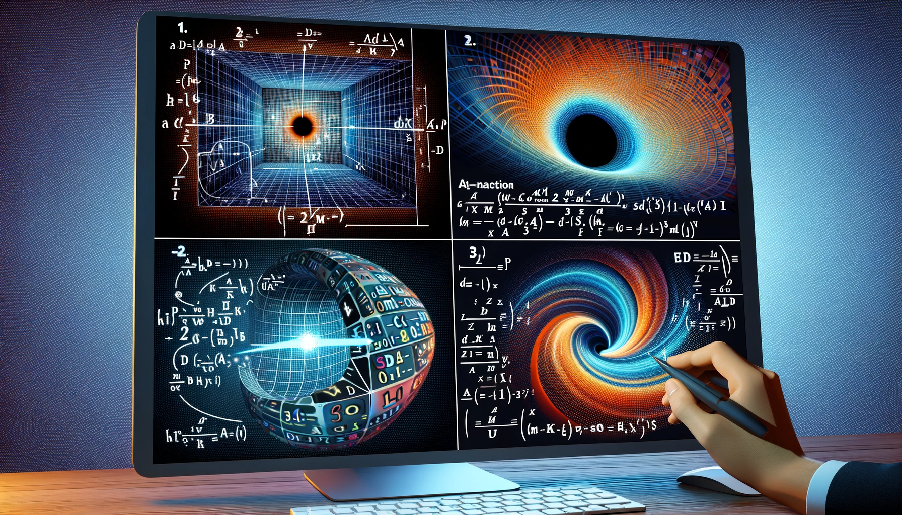
Notes:
The first part illustrates the 3+1 Decomposition with a 4D spacetime grid being sliced into 3D spatial layers over time.
The second shows the ADM Action with a mathematical equation integrated over a curved spacetime backdrop.
The third depicts the Derivation of ADM Action with symbols and equations transitioning from 4D to 3D representations.
The fourth highlights the Significance in Numerical Relativity with a computer screen displaying a black hole simulation based on the ADM formalism.

Slide 16
Applications
Numerical relativity and simulations
Understanding Black Holes
Predicting and Analyzing Gravitational Waves
Cosmological Models of the Universe
Canonical Quantum Gravity (Quantizing Gravity attempt)
Testing GR under extreme conditions
Notes:
Numerical Relativity and Simulations:
The ADM formalism's primary application is in numerical relativity, where it is used to simulate the dynamics of spacetime and gravitational fields. This is crucial for studying scenarios that are too complex for analytical solutions.
It enables the simulation of black hole mergers, neutron star collisions, and the generation of gravitational waves, which are central to the research in gravitational wave astronomy.
Understanding Black Holes:
The formalism allows for the detailed study of the properties and dynamics of black holes. It is instrumental in simulating the event horizons, accretion disks, and the merging of binary black holes.
Gravitational Wave Physics:
ADM formalism has been critical in predicting and analyzing gravitational waves. The simulations based on this formalism have been key to interpreting data from gravitational wave detectors like LIGO and Virgo.
Cosmological Models:
In cosmology, the ADM formalism is used to explore different models of the universe, including its evolution and behavior under various scenarios, such as during the early stages of the Big Bang.
Canonical Quantum Gravity:
The formalism's approach to decomposing spacetime is also applied in attempts to quantize gravity, particularly in approaches to canonical quantum gravity. It lays the groundwork for theories that attempt to unify General Relativity with quantum mechanics.
Testing General Relativity:
The ADM formalism provides a framework to test the predictions of General Relativity under extreme conditions, such as near the singularities and event horizons of black holes or in the early universe.

